Slide 1
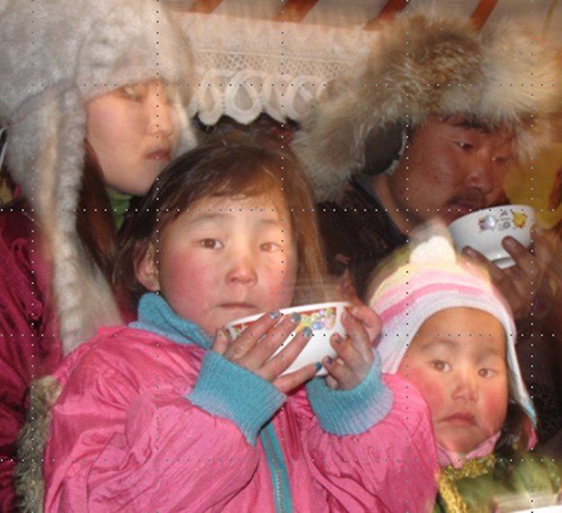
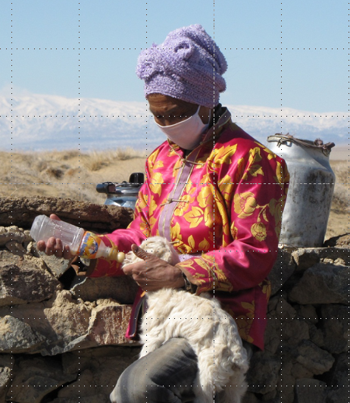
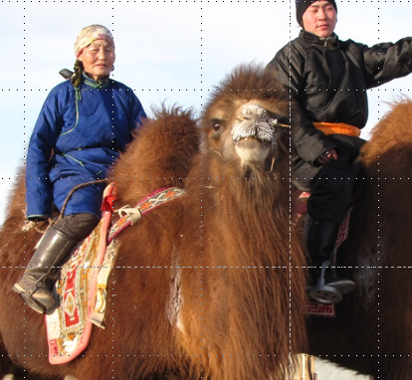
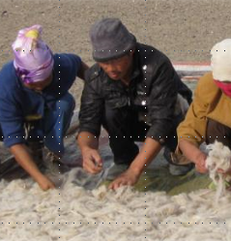
Human Impacts of
Climate Change in Mongolia, Session 4
Oct. 16, 2021
ACMS Online Field School

Slide 2
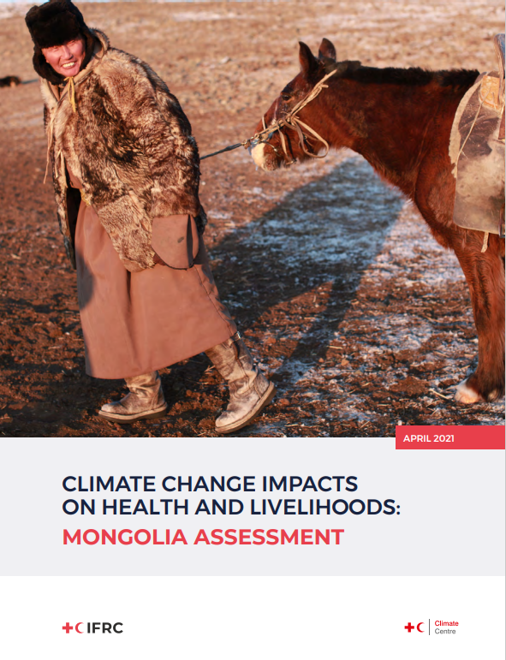
Plan for today
Review and discussion of IFRC report
Discussion of adaptation and interventions
https://reliefweb.int/sites/reliefweb.int/files/resources/RCRC_IFRC-Country-assessments-MONGOLIA-3.pdf

Slide 3
Analyzing our text
Consider methods, author(s), purpose, biases, themes and discourses
IFRC = International Federation of the Red Cross and Red Crescent
  Broad health focus
  Delivers humanitarian aid through local chapters
Report is a tool for targeting action
Use of research lit. and key informant quotes throughout

Slide 4
Climate change predictions
Certain:
Warming
  Faster than global average
  +2.2 degrees C since 1940*
  Additional 2 to 6 degree C warming this century
  Faster in the mountains
Heatwaves, especially in south and southwest
Drying
Highly likely:
Seasons “more pronounced”
  Longer summer (based on temp. definition)
More frequent dzud
  More summer drought
  More winter snow (15-50%)
Increased intense rainfall leading to landslides, floods, and erosion
*Third National Communication of Mongolia (TNC). 2018. Ulaanbaatar: Climate Change Project Implementing Unit of Environment and Climate Fund, Ministry of Environment and Tourism of Mongolia.

Slide 5
Observed and increasing impacts
Water scarcity
Reduced crop production
Increased dzud (every 4 or 5 years vs. every 10 years)
Increased air pollution (e.g. dust)
Health impacts
Poverty trap
Rural-to-urban migration

Slide 6
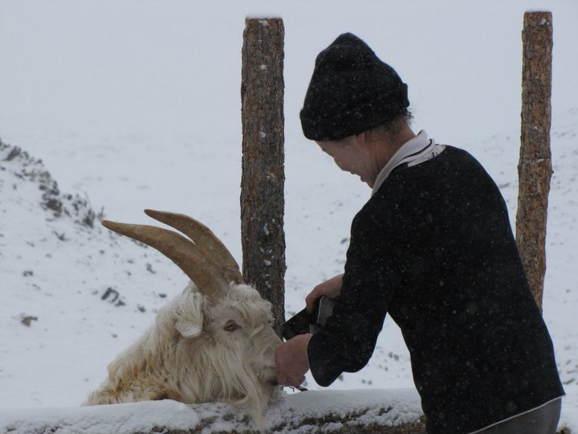
“One Health” approach
Human health and animal health intertwined
Take care of animal health to protect human health
In Mongolia, consider diseases spread by vectors like ticks, fleas
A herder giving extra food to a goat, Bayanlig

Slide 7
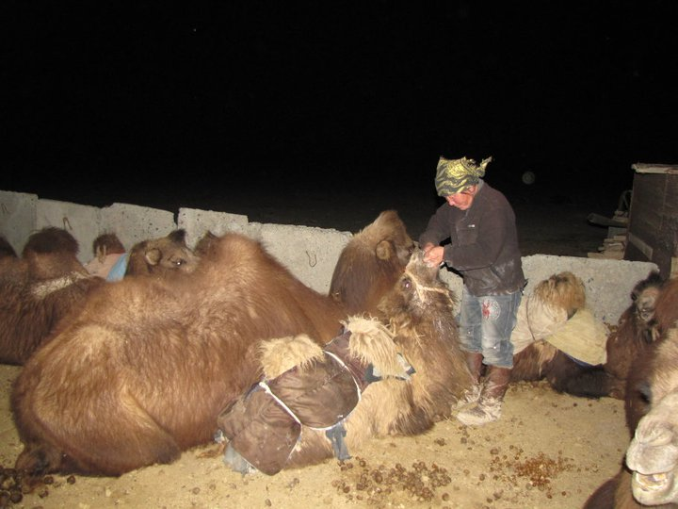
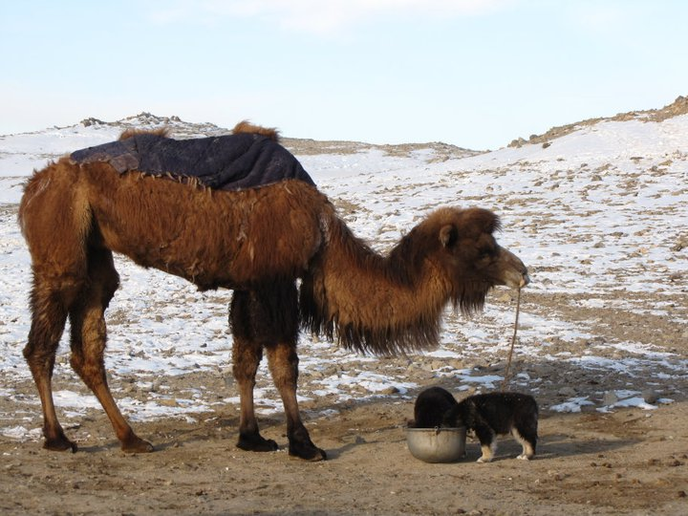
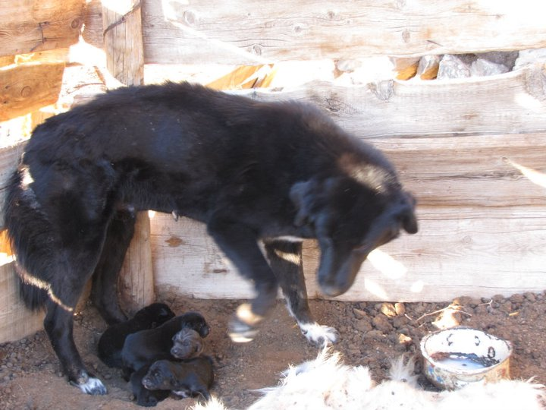
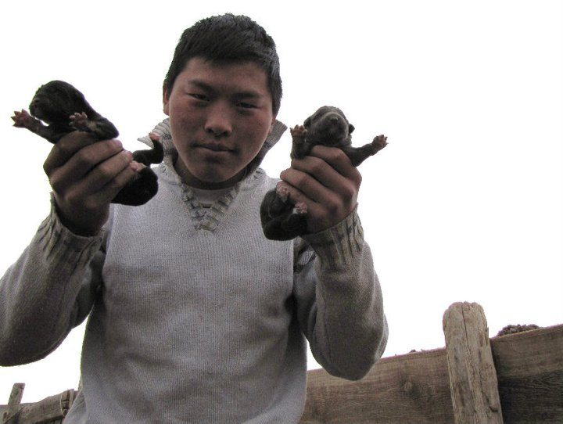

Slide 8
Common Interventions for Climate Risk Management
Post-disaster relief
Forecast-based finance
Livelihood diversification
Insurance
Herder groups
Education

Slide 9
Post-disaster relief
National Emergency Management Agency (NEMA)
United Nations Agencies
World Vision (NGO)
Save the Children (NGO)
Friends, family, hometown networks in urban areas
  Focus on most vulnerable households
  Deliver food, animal fodder, medicines, clothes, cash
  Help restocking livestock

Slide 10
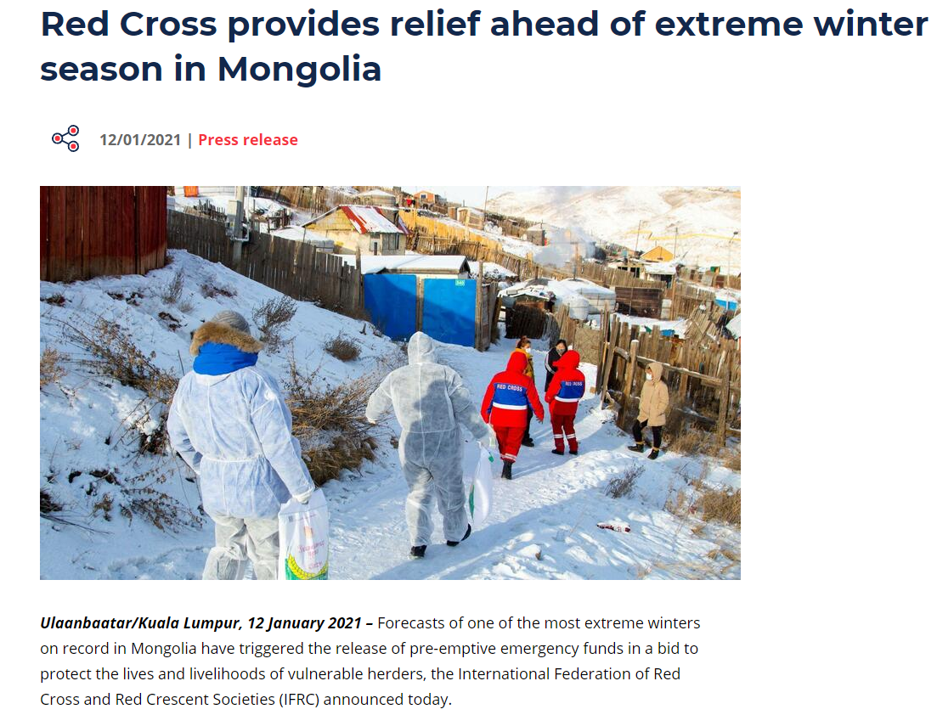
Forecast-based Financing, i.e. pre-disaster aid
https://www.ifrc.org/press-release/red-cross-provides-relief-ahead-extreme-winter-season-mongolia

Slide 11
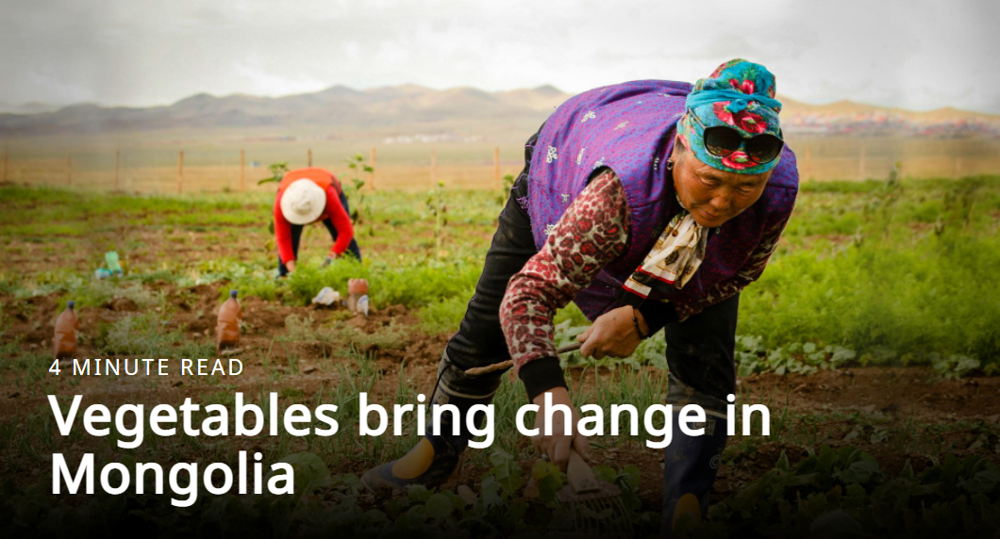
Livelihood diversification
Vegetable farming:
  Livelihood and dietary supplement to herding
    Conflict with nomadism?
  Interim emergency solution when livestock are lost
  Common in some regions
  Appropriate to local culture and environment?
Handicrafts
Other livelihoods
New Zealand org. Tearfund and Family Ag. Resources Mongolia (FARM) taught farming to herders following dzud.
https://issuu.com/tearfundnz/docs/tearfund_correspondent_december_2020_final_no_crop/s/11374119

Slide 12
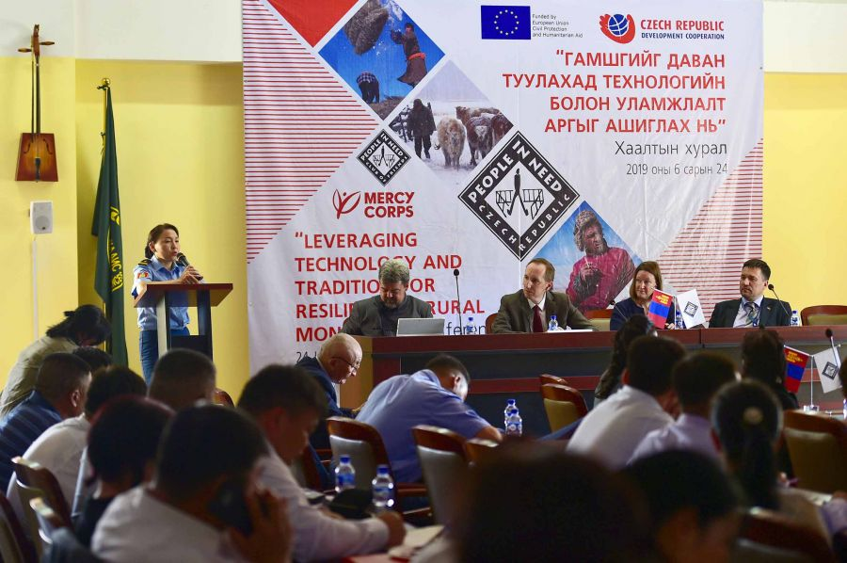
Mercy Corps approach to livelihood security
Mercy Corps (NGO) focused on reducing vulnerability, supporting entrepreneurship
The “Gobi Initiative”
Microfinance program
Early (dzud) warning information network program
Ended program in 2021:
“After 22 years,… we decided it was time to close down our operations and let our amazing local partners take the lead.” https://www.mercycorps.org/where-we-work/mongolia
Mercy Corps reflection on legacy: https://www.mercycorps.org/blog/celebrating-legacy-mercy-corps-mongolia
Mercy Corps partnered with other organizations on a tech-based early warning system, https://montsame.mn/en/read/194008

Slide 13
Insurance
Index-based livestock insurance (IBLI)
  Compensation for livestock based on community-wide stats
Herders must purchase insurance before mid-summer
  Some complain it is too soon
Most vulnerable households may be unable to afford it
Other types and levels of insurance available
World Bank project with government of Mongolia

Slide 14
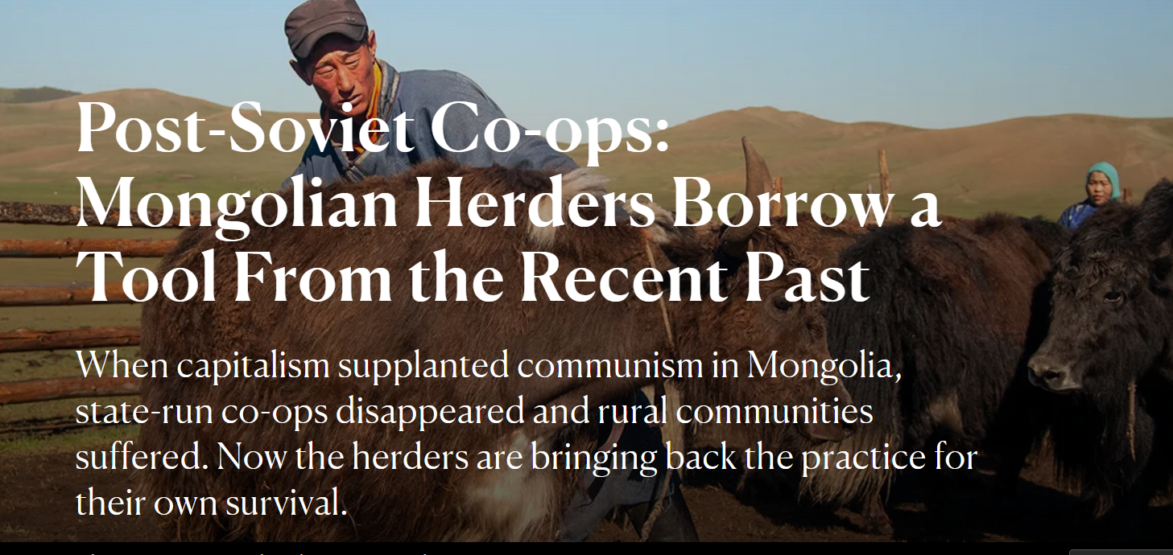
Herder groups: collective approaches to herding challenges
Herder groups
Pasture user groups
Co-ops
Not quite like communist-era negdel, “collectives”
Article from Yes! Magazine, Sarah Trent, 2019 https://www.yesmagazine.org/issue/death/2019/08/16/mongolia-herding-cooperatives-rural-communities-survival

Slide 15
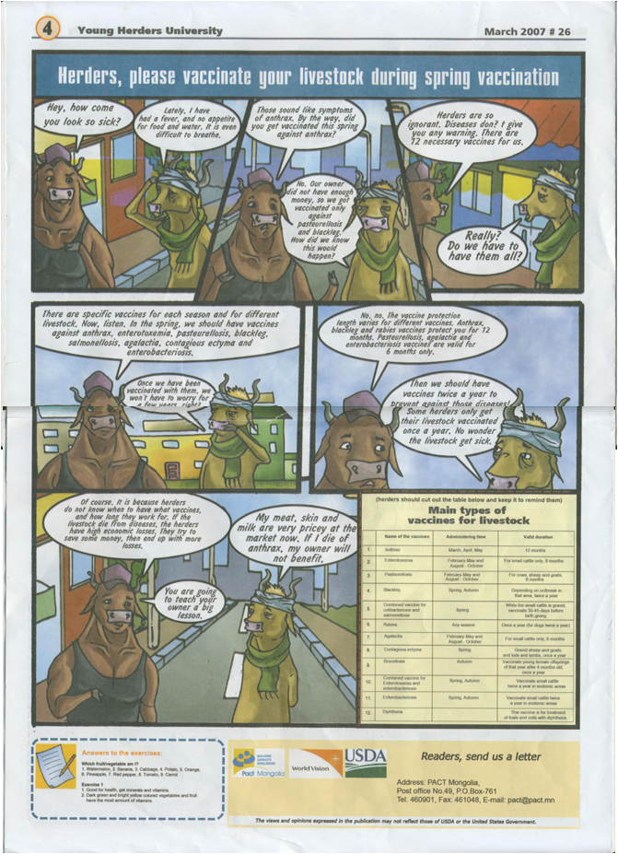
Education as Intervention
Ex.: Young Herder University newspaper (English language sample) by Pact (NGO)
(Western) science-based lessons
Ignorant or disparaging of local knowledge (and TEK)
Education often targets mindset or values as well as conveying knowledge

Slide 16
Education using Local Knowledge
Ex., Bayankhongor Province’s publication, “Getting Through Hard Times” handbook
  Collected wisdom from experienced herders
  Detailed advice for keeping livestock warm, giving supplemental feed, etc.
  Specific to local environment and culture
  Distributed to herders throughout province
  Some advice could conflict with scientific textbook
  Could seem strange/wrong to cultural outsiders (ethnocentrism)
  The book text and my translation: https://docs.google.com/document/d/1ZN8NV_xRVu2U5l43YED_UnGIt23x9YcQ/edit?usp=sharing&ouid=110700196999115977012&rtpof=true&sd=true

Slide 17
Examples from text:
“Өвсөөр мал тэжээх—Feeding with grass/hay
Өвсөөр мал тэжээхэд түүнийг идэмж шингэцийг сайжруулахын тулд түүнийг урьдчилан бага зэргийн боловсруулалт хийж бэлтгэл нь зүйтэй.—When you feed with hay, in order to improve the animals’ digestion of it, it’s a good idea to process it a little first.
Өвсийг бог малд 1-2 см бод малд 4-5 см урттай хэрчиж, жижигдээд дангаар буюу хивэгтэй хольж ядарсан малд өгнө. Ядарсан малд хэрчсэн өвсийг 8-10 л буцлам халуун усанд дэвтээж дээрээс нь 10-20 г давс нэмж 2-3 цаг байлгана. Ингэж дэвтээхэд өвсний үнэр, амт сайжирч зөөлөрдөг. –Cut grass to 1-2 cm for small stock, 4-5 cm for large stock, mix with bran and give to the tired animals. Give tired animals a brew of grass, 8-10 liters hot water, and 10-20 grams salt. Let sit 2-3 hours prior to feeding. If you steep it this way, the grass’s smell and taste improve and become smooth.”
“Тарваганы ходоод—Marmot’s belly
Тарваганы сайн ходоодонд хамгийн сайн чанартай нялх ногоо, үндсэн байдаг тул турж доройтсон мал, сэнсэрсэн хурга тэжээхэд түргэн тэнхрүүлдэг. Гэхдээ зарим тарваганы ходоодонд цагаан хорхой байдаг тул өгөхдөө буцалгаж давсай хольж өгнө. —Marmot belly: Take the good parts of a marmot’s belly and mix with the very best baby greens, and give to the weak, thin animals and the early-born “bent” lambs (who have had insufficient milk to help them get better quickly). Some marmot belly has white worms, so boil it, then mix with salt.”

Slide 18
Discussion: What kinds of education are needed, appropriate, effective?
E.g., IFRC’s recommendation (p. 44): “Enhance knowledge and awareness about the science and impacts of weather and climate change within the National Society and at the community-level with a focus on their potential impacts on disasters and on people’s health and livelihoods.”

