Slide 1
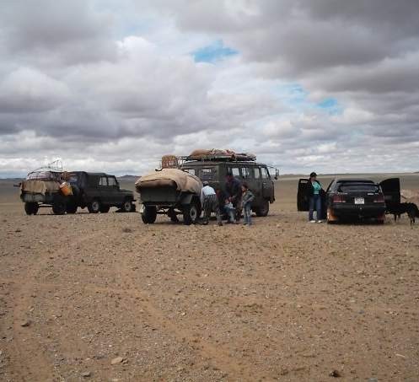
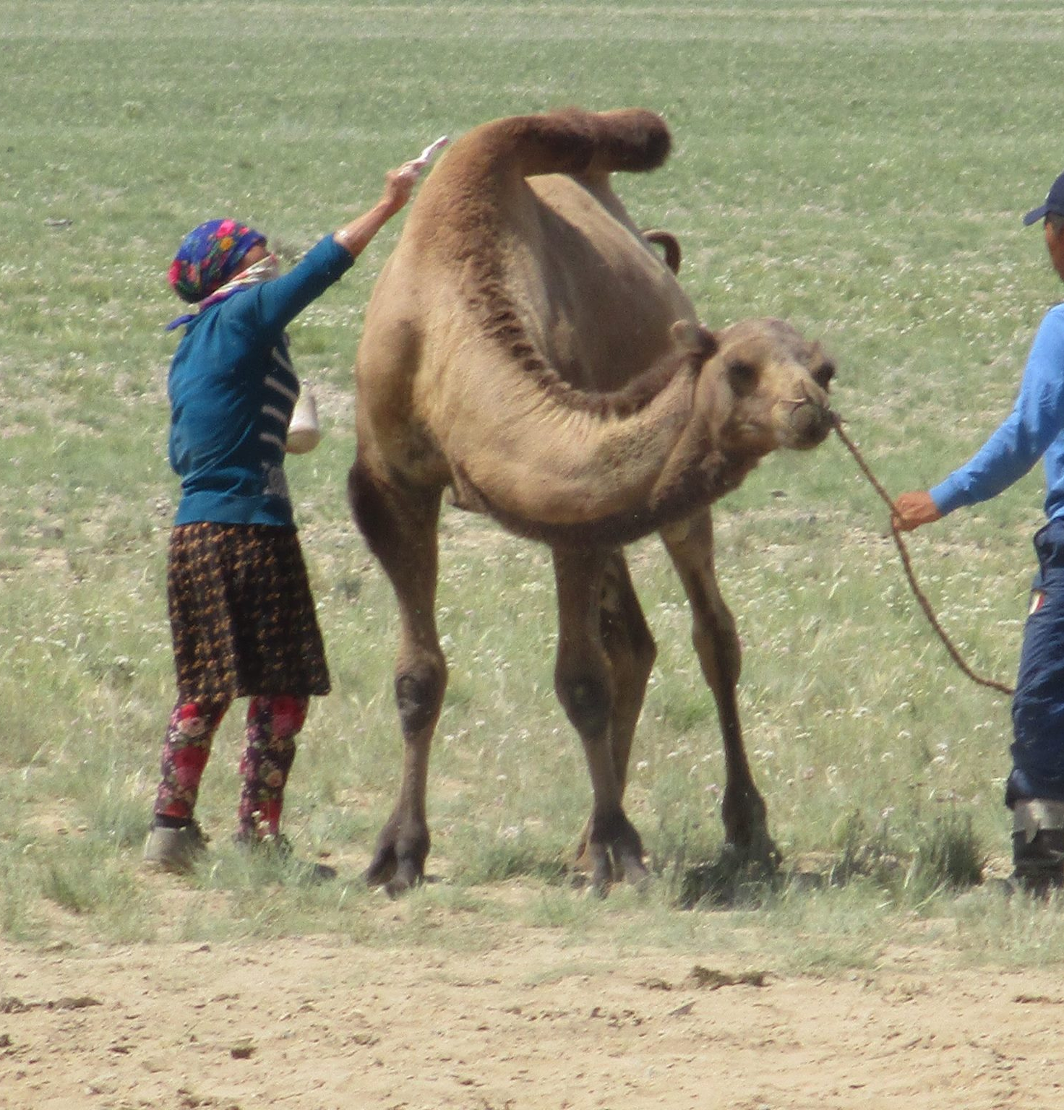
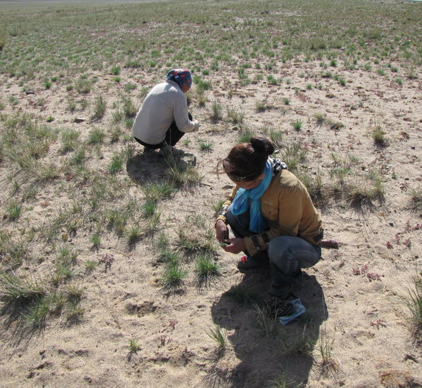
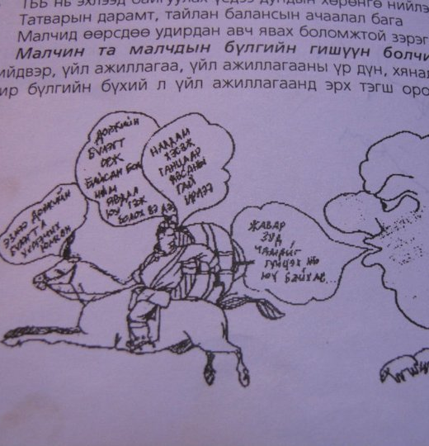
Human Impacts of
Climate Change in Mongolia, Session 1
September 25, 2021
ACMS Online Field School

Slide 2
Plan for today
Instructor introduction
Overview of the course
  Participation guidelines
  Urgency of climate change challenge
  Rural/pastoralism focus of this course
  Relation of this course to “field school”
  Interdisciplinarity, the social sciences, and anthropology
  Questions about the course
Participant introductions
Discussion: major concerns and questions re: impacts of climate change in Mongolia
Introducing hw: “The Anthropologist” and forum

Slide 3
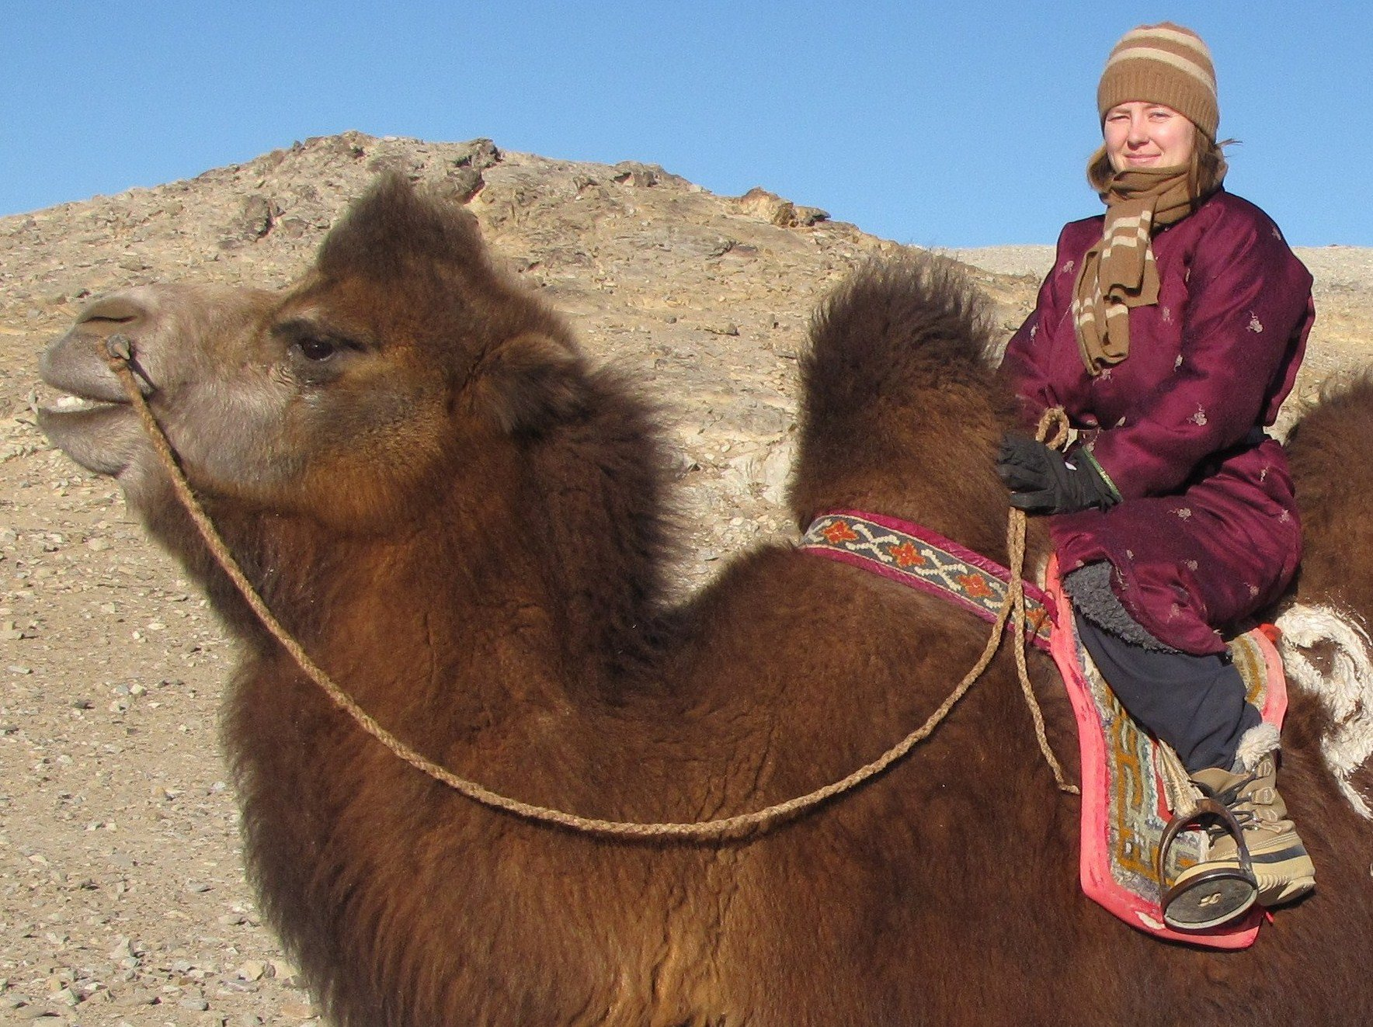
About Me (Annika)
Former Peace Corps volunteer (Bornuur, Mongolia, 2004-2006)
Cultural Anthropology PhD (U. Arizona, 2014) with environmental focus
Liberal arts college professor, 2014-2021

Slide 4
Course Participation Guidelines
Sessions are recorded, except for breakout rooms
Let’s hear many different voices in our discussions
  Unmute and talk, or type into chat
If I call on you, you can choose to “pass”
You may politely correct or disagree with me and each other
Treat each other with respect, avoiding stereotypes
Please let me know if you are uncomfortable with something I said or something that happened in class
It is okay to join sessions late or leave early
Mid-week activities (AKA homework) are encouraged but there are no penalties for not completing them

Slide 5
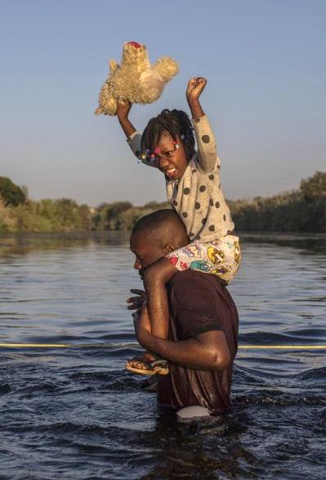
Urgency of Climate Change Challenge (re: human impacts)
Increase in natural disasters
  Hurricanes
  Wildfires
  Flooding
  Drought
  Heat waves
  Dzud? (Mongolian winter disaster that causes death of livestock)
Diseases
Food insecurity
Inequitable impacts
Climate refugee-ism
Pluralia interactions with other problems
  Haitian refugees crossing border to USA, Source: visalgroup.com

Slide 6
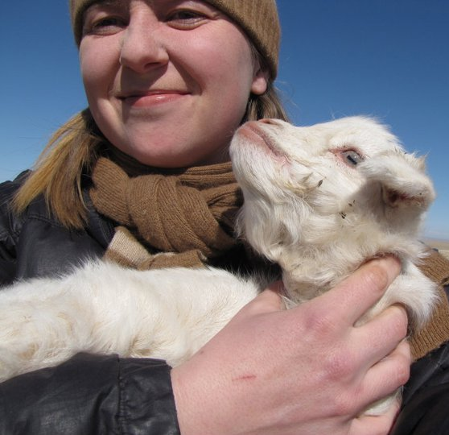
Rural/Pastoralism Focus of our Course
Rural communities are among most affected by climate change—reliant on weather and natural resources
Importance of herding livelihoods in Mongolia
My fieldwork has had rural focus (Bayanlig, Bayankhongor herders and dzud)
See also ACMS field course on climate and health

Slide 7
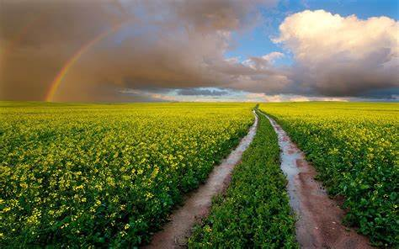
Relation of our “Online Field School” course to Fieldwork
Typically, a “field course” takes place in “the field” and participants practice “fieldwork”
  What is “fieldwork” in your experience, and what (or where) is your “field”?
  Making this a virtual field course
  ACMS field courses in Mongolia in Summer 2022

Slide 8
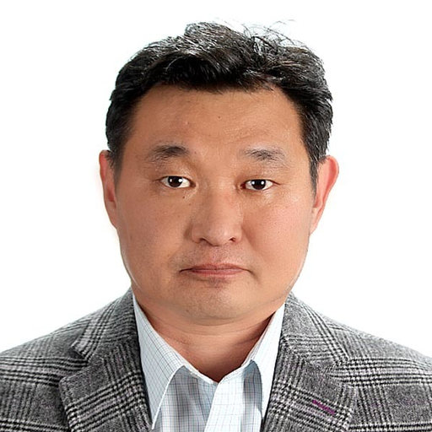
Our field correspondent: Batbuyan Batjav, PhD
Geographer
  Human/social geographer
  Environmental challenges
  Nomadic pastoralism
Conducting and recording interviews for our class
Co-instructor of ACMS field course in 2022
B. BATBUYAN | PhD (researchgate.net)

Slide 9
Interdisciplinarity and the Social Sciences
Humanities
Natural Sciences
Social Sciences
Sociology
Economics
Psychology
Anthropology
Religion
Geography
Communication
Physics
Art
Ecology
Literature

Slide 10
Social sciences and climate change
Social sciences:
  Study cultures and social organization
  Analyze behaviors, group dynamics, and social institutions
  Address social problems
    “Applied” social sciences
Application of social sciences to address climate change:
  How human behaviors, cultures, and institutions contribute to climate change
    How to change to mitigate climate change
  Impacts of climate change on communities and cultures
    Strategies for adaptation (“resilience”) and/or climate justice

Slide 11

Anthropology, “study of humans,” a broad discipline
In the US, 4 major anthropology subfields:
Cultural anthropology
Linguistic anthro.
Physical/biological anthro.
Archaeology
+ many other specialties, e.g. “medical anthro,” “environmental,” etc.
Image source: U. Montana

Slide 12
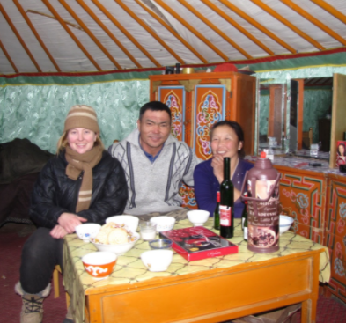
Cultural Anthro. Fieldwork Methods
Ethnographic fieldwork
  Cultural immersion
  Long duration
  Participant-observation
  Fieldnotes
  Semi-structured interviews
  Grounded theory
  Qualitative data analysis

Slide 13
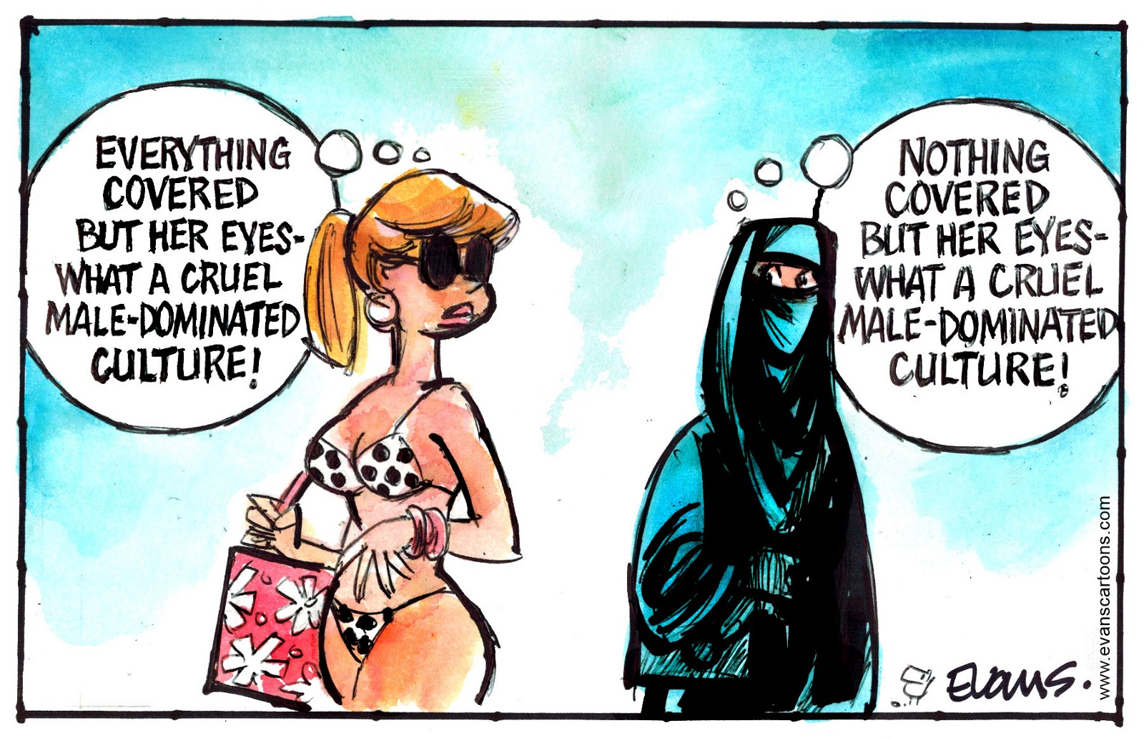
Cultural Anthro. Core Perspectives
Awareness of our ethnocentrism (cultural bias)
Use of cultural relativism (openness, non-bias)
Reflexivity (self-awareness) in research and analysis
Ethnocentrism illustration,
Image source: www.evanscartoons.com

Slide 14
Course format and questions
Saturday, September 25: Introductions
Wed., Sept. 29/Mid-week: Film, “The Anthropologist”
Saturday, October 2: Social science studies of climate impacts in Mongolia
Wed., Oct. 6/Mid-week: Analyze climate interviews
Saturday, October 9: Discussion of data analysis
Wed., Oct. 13/Mid-week: Group projects—could be research design, interviews, etc.
Saturday, October 16: Presentation and discussion of projects
Questions about this course?

Slide 15
About You
All participants are welcome and encouraged to participate actively in this course, regardless of your level of study or area of expertise!
Where from? And where you are now?
Occupation or interests?
Have you studied climate change?
Have you studied about, visited, or lived in Mongolia?
What would you like to get from this course?
[Get to know some classmates in groups, 10 min.]

Slide 16
Discussion: major concerns and questions re: human impacts of climate change in Mongolia—class brainstorm
[List will be produced by participants during live session]

Slide 17
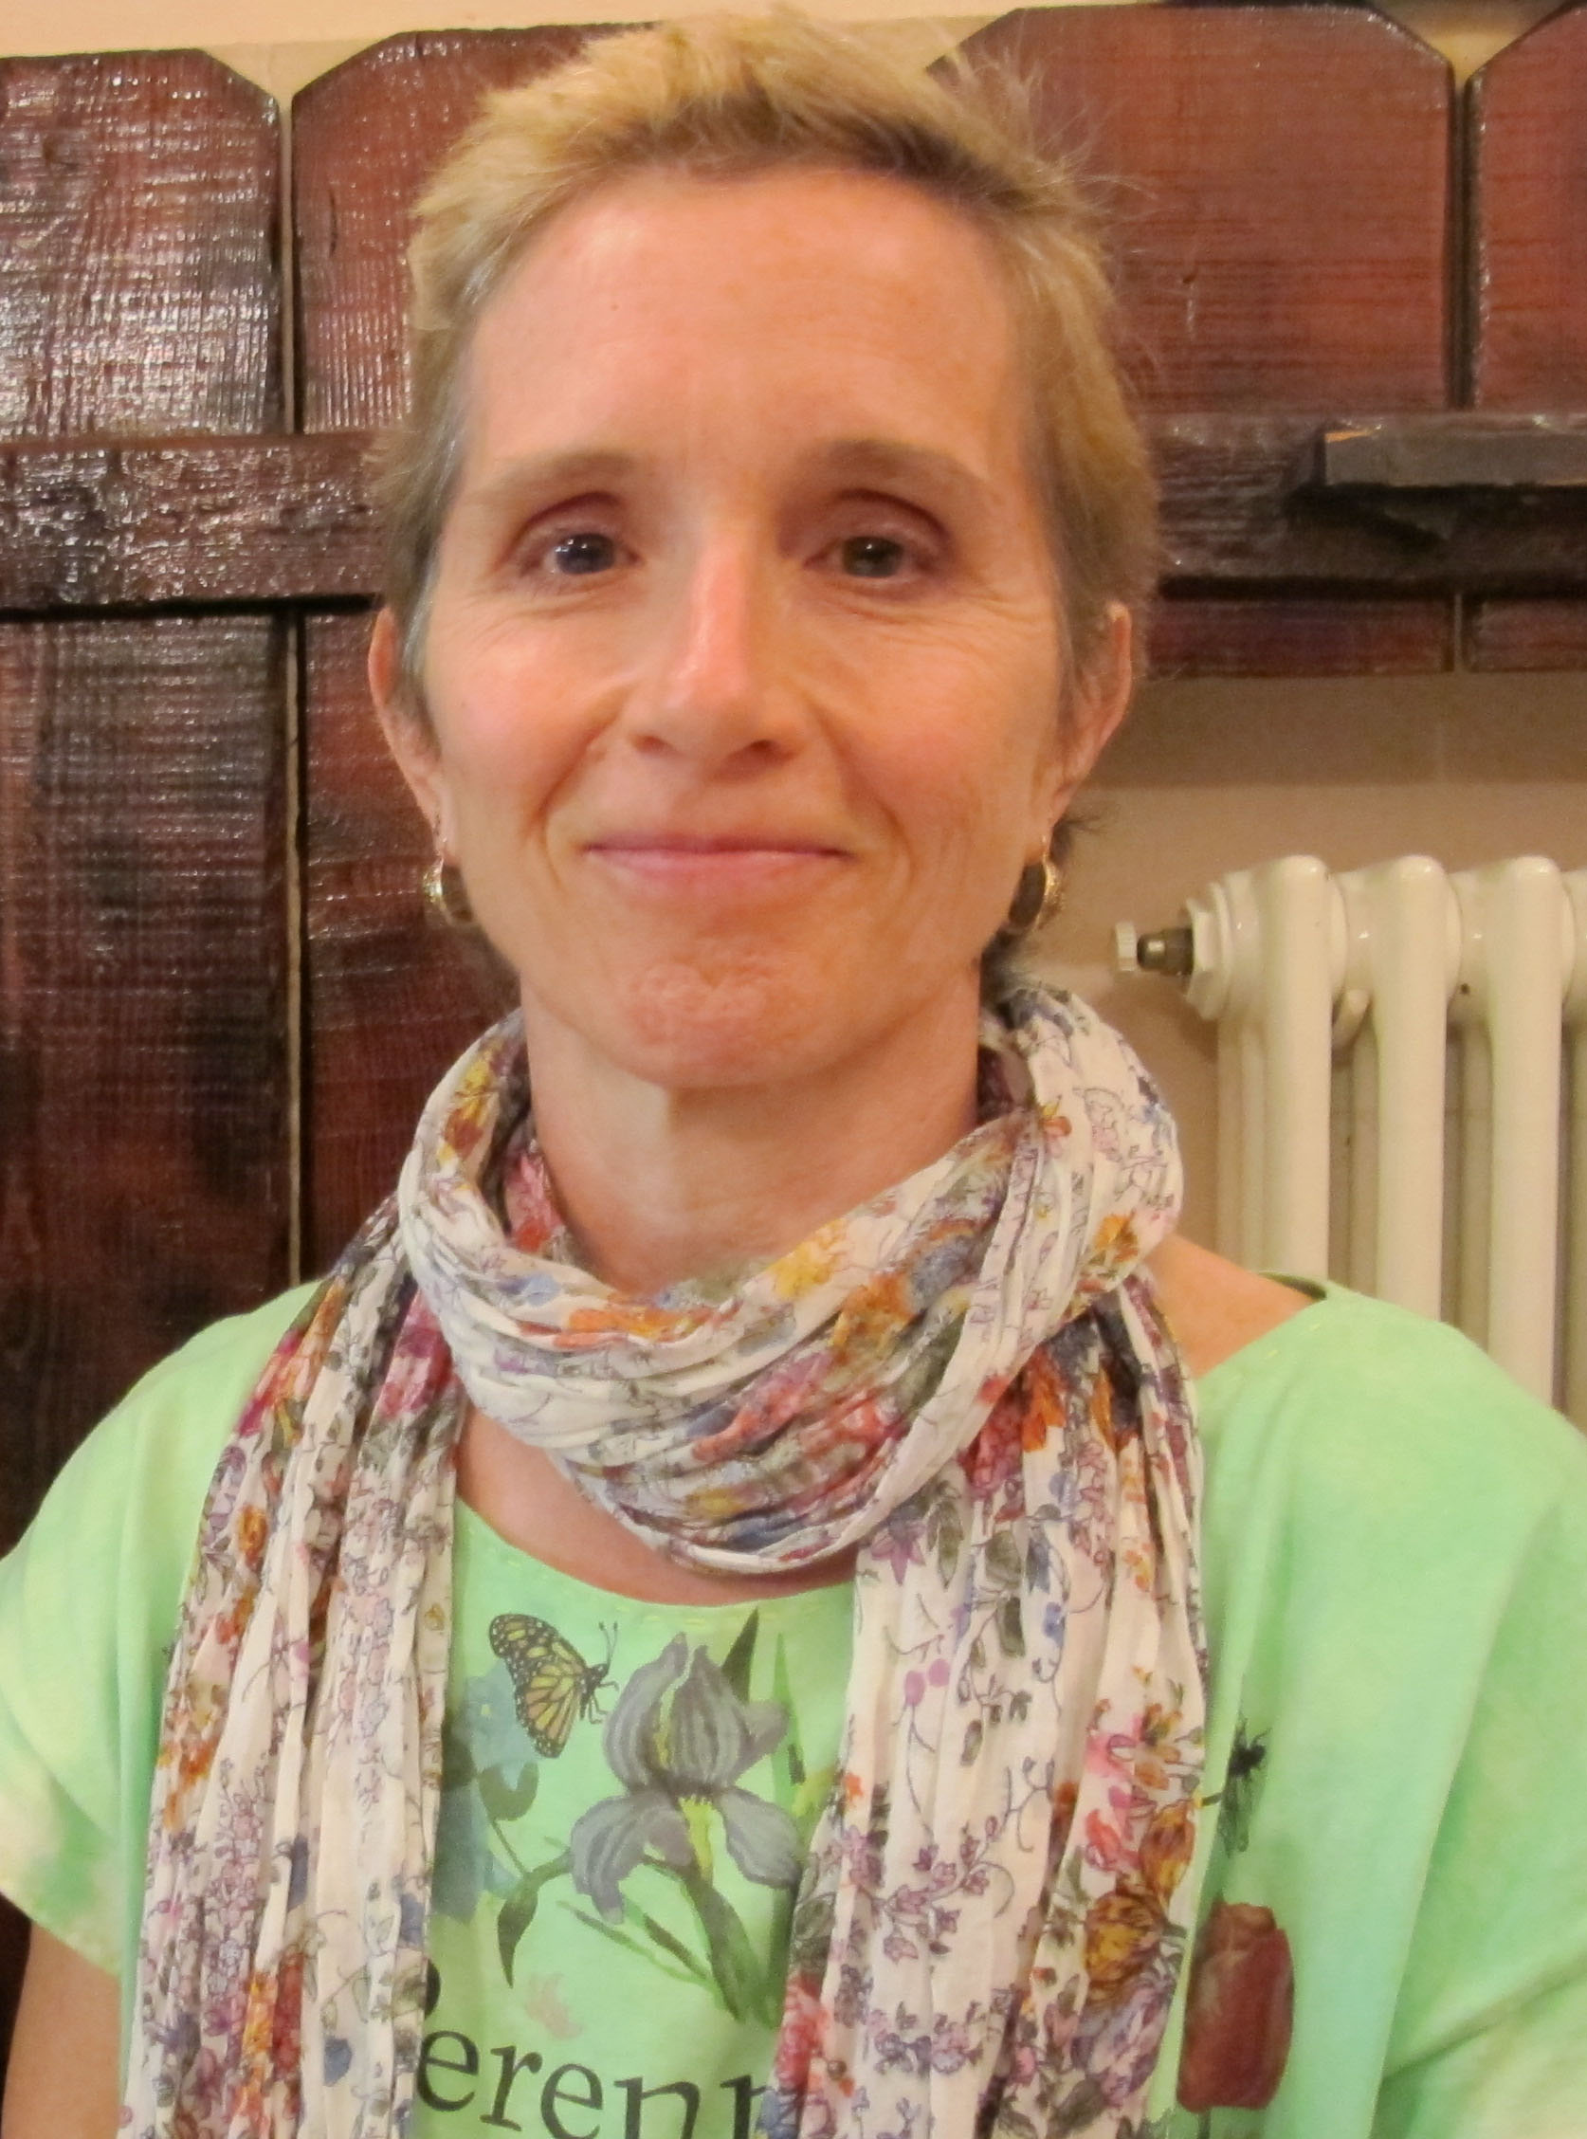
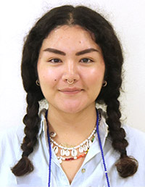
Intro to the film, “The Anthropologist”
2015 Documentary (Ironbound Films)
Focus on anthropology’s unique perspective
Anthropology’s relevance to studying global problems like climate change?
Anthropologist Susan Crate and daughter Kathryn Yegorov-Crate
Source: Susie Crate's Home Page (gmu.edu)
UT College of Liberal Arts: (utexas.edu)
Follows mother-daughter relationships
  Margaret Mead and Mary Catherine Bateson
  Susan Crate and Kathryn Yegorov-Crate

Slide 18
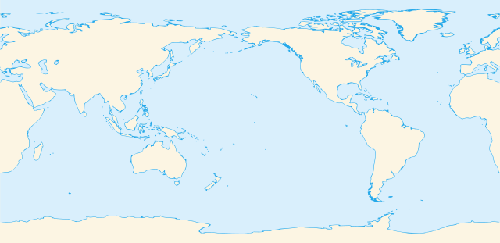
Climate change vignettes in the film
Sakha Republic, Russia
US Atlantic Coast
Kiribati
Peru
Susan Crate has many years of experience researching in Sakha Republic, but not in the other locations. What difference does experience with local culture make for studying climate change impacts?

Slide 19
Questions for online forum:
What does the film say about the value of an anthropological perspective for studying climate change and its impacts? Do you agree?
You get some glimpses of Susan Crate’s interactions with people in several different locations as she learns about their experiences of climate change
  What do you think she does well?
  Is there anything you would question or critique about her research interactions based on what you see in this film? i.e., What might you do differently if you were the researcher?
Why do you think the filmmakers decided to feature a mother-daughter relationship (actually 2)? Does this add anything to the film?
Or, you can make and answer your own question, or share any reflections that you have. Responding to each other’s comments in the forum is encouraged.

